Slide 1
Shallow water flow field inference using convolutional neural networks with particle images
ACSE 9 - Independent Research Project
Mingrui Zhang
Supervisor: Matthew Piggott, James Percival
Notes:
Hello everyone, my name is Mingrui Zhang and my independent research project is shallow water flow field inference using convolutional networks with particle images. My supervisor is Matthew Piggott and James Percival.

Slide 2
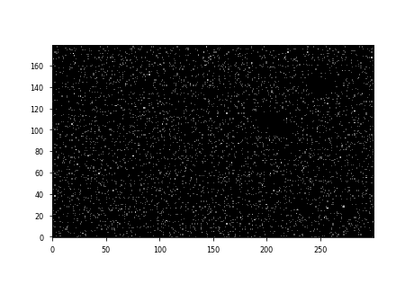
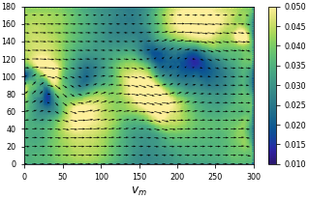
Content
Introduction
Research Purpose
Data Generation
Network Architecture
Results
Discussion
Q&A
Notes:
The presentation is divided into 8 parts. My project is highly related to Particle Image Velocimetry techniques. And I will introduce some background knowledge about it before we go detail. The right part of slide is a sample result of my project, the upper image represent the particle image pair and the lower one represent the velocity inference.

Slide 3
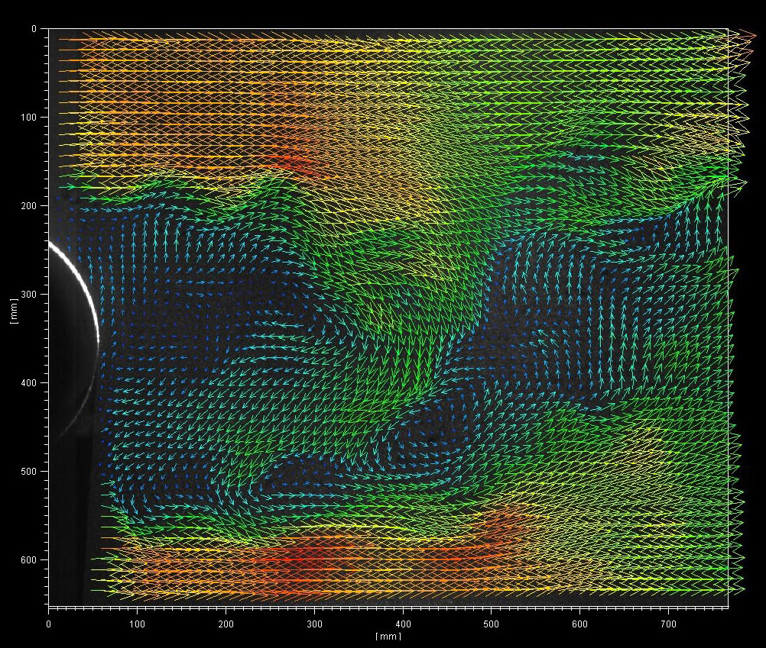
Introduction
PIV method
In experimental fluid mechanics, image processing techniques are used for flow field identification and prediction such as the measurement of flow velocities.
Particle Image Velocimetry (PIV) is one of the most popular measurement technique. The method is used to obtain instantaneous velocity measurements and related properties in fluids using frame pairs.
PIV results sample
(https://www.seika-di.com/en/measurement/principle_of_piv.html)
Notes:
Particle Image Velocimetry, or PIV in short, is a image processing technique which is commonly used in experimental fluid mechanics. When setting a PIV experiment, the target fluid flow is seeded by tracers. They are illuminated during the experiments. Then a camera will take videos. The PIV technique calculate the velocity of the particles between two consecutive video frames. Due to the time interval between the frame is quite small. The average velocity calculated can represent the instantaneous velocity.

Slide 4
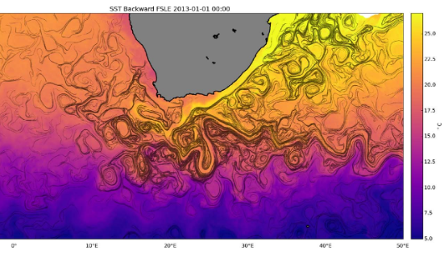
Introduction
Difficulties for PIV method applied to ocean modelling.
Real oceanic data is much more sparse than lab-scale data - there are not always dense tracers in the flow field such as a high density of particles. It is hard for PIV technique to search for correlation between particles in a sparsely seeded image pair.
Also, real oceanic data usually covers very large spatial scales, an extremely high computational cost can therefore be required for PIV technique to process these data.
Lagrangian ocean analysis
(Lagrangian ocean analysis: Fundamentals and practices
E Van Sebille, SM Griffies, R Abernathey, TP Adams et al
Ocean Modelling, 2018)
Notes:
In ocean modelling, Lagrange analysis is a useful method. PIV technique can be regarded as Lagrange method because it is somehow tracking small group of particles.
It is ideally to use in lab environment for small scale fluid. But there are some difficulties when applying to ocean modelling. Real oceanic data is much more sparse and there are not always dense tracers like high density particles. Also, the oceanic data usually covers very large spatial scales, it will require a extreme high computational cost if use PIV technique to process these data.

Slide 5
Research Purpose
Objective
Develop a neural network alternative to PIV
Generate suitable synthetic dataset for network training
The system is expected to perform fluid flow inference given particle images
Robust: handle sparse particle images
High efficiency: real-time processing of particle images and perform inference
Notes:
Machine learning techniques have shown great advantages solving complex dynamic problems. Therefore, we consider using machine learning techniques to handle the difficulties mentioned above. So here comes the research purpose, to develop a neural network alternative to PIV. It can perform fluid flow inference given particle images. Specially, the network is expected to handle sparse particle images with high efficiency. Also, there is no standard particle images dataset for training a neural network, it also requires generating suitable synthetic dataset for training in this project.

Slide 6
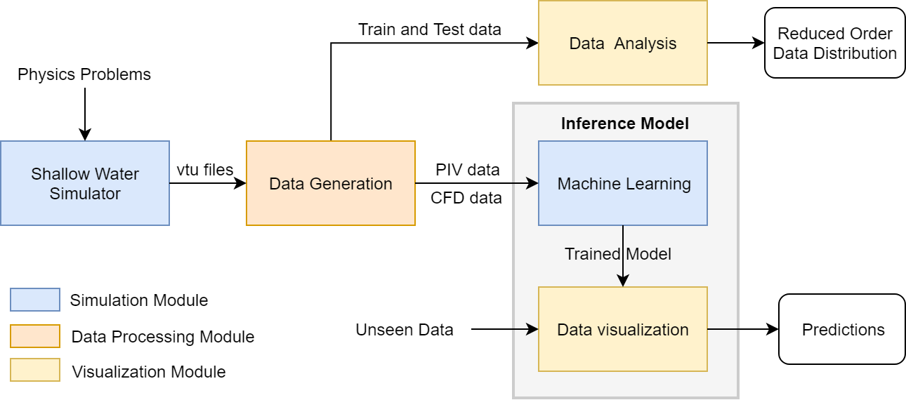
Software Architecture
Notes:
Here is the architecture of the whole software. The workflow of the architecture is also shown in this graph. The shallow water simulator perform the CFD simulation and output vtu files as the ground truth. Also, the CFD results are used to generate particle images by data generation module. Then the prepared training data is fed to machine learning module and used to train the neural network. Finally, the trained model is sent to the data visualization module and perform predictions according to input data. Also, a data analysis module is provided here for analyzing the property of training and test data.

Slide 7


Software Architecture
Platform and libraries
Firedrake
Thetis
PaticleModule
Pytorch
Google Colab
https://www.firedrakeproject.org/#
https://thetisproject.org/
https://github.com/jrper/ParticleModule
https://pytorch.org/
https://colab.research.google.com
Notes:
Firedrake: automated system for sovlingpartial differential equations using the finite element method (FEM).
Thetis: Thetis is an unstructured mesh based coastal ocean model built using the Firedrake finite element framework.
These two support the shallow water simulator.
PartcleModule is a package which can calculate fluid streamline using particles given CFD vtu files.
Pytorch: PyTorch is a Python package that provides two high-level features: Tensor computation (like NumPy)
with strong GPU acceleration; Deep neural networks built on a tape-based auto-grad system.
All the machine experiments are conducted on google colab.

Slide 8
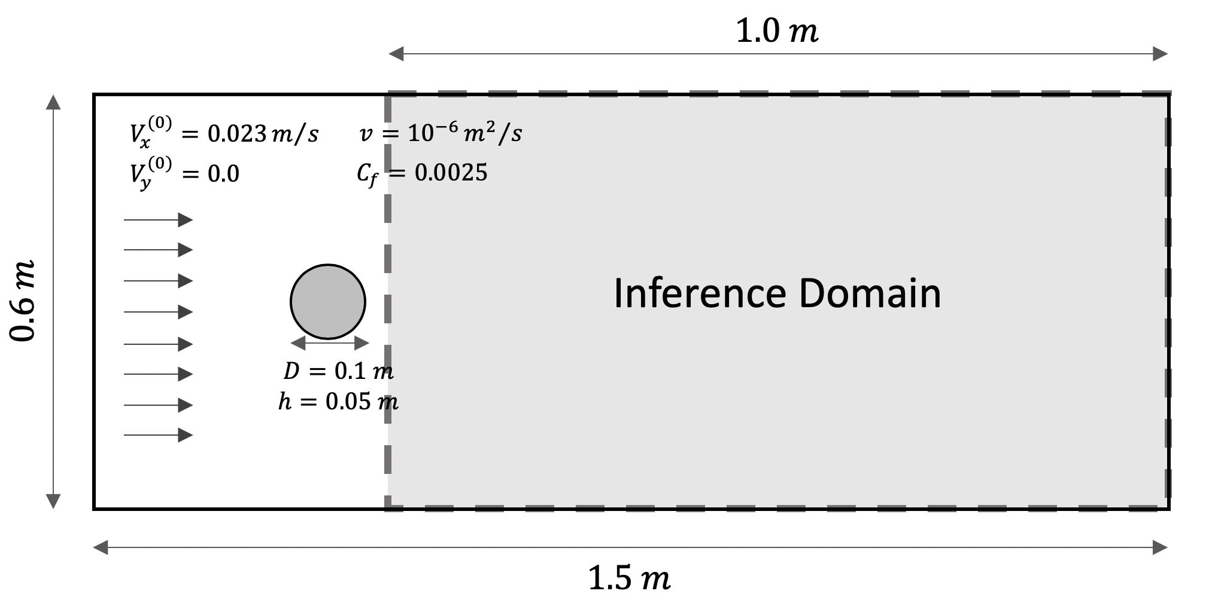
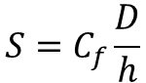
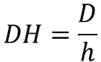
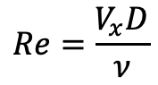
Data Generation
Physical and computational setting
Key non-dimensional parameters
$$Re=\frac{V_{x}D}{ν}$$
$$DH=\frac{D}{h}$$
$$S=C_{f}\frac{D}{h}$$
Notes:
In this slide, the physical and computational setting is shown. It is a shallow water flow past cylinder problem. Because the upstream is simply laminar flow which is not interesting, so we select the downstream wake as the inference domain, which is shown as the shadow area in the graph. The key non-dimensional parameters listed on the right decide the structure of the flow.

Slide 9
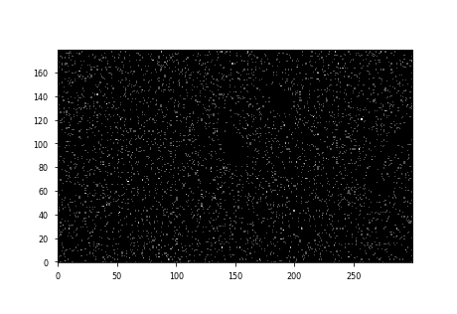
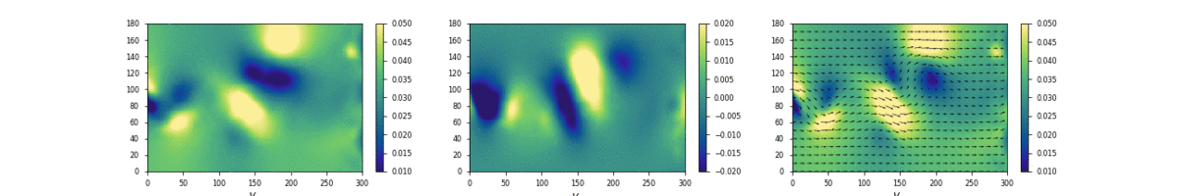
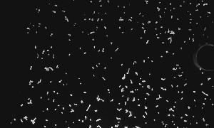
Flow field examples
CFD
Synthetic particles
Lab particles
Notes:
Here are some samples of different kinds of data. They are CFD data, synthetic particles and lab particles. The left movie shows the CFD data, the color represent the velocity magnitude and the arrows represent the velocity direction. For the particle images, the synthetic and lab images are shown on the middle and right respectively. It could be observed that the synthetic particle images and lab particle images are quite different. There are many parameters that would influence the quality of the particle image in real world. For example, some particles may gather together and consist a larger particle, the different illumination conditions will cause different gray values for particles.

Slide 10
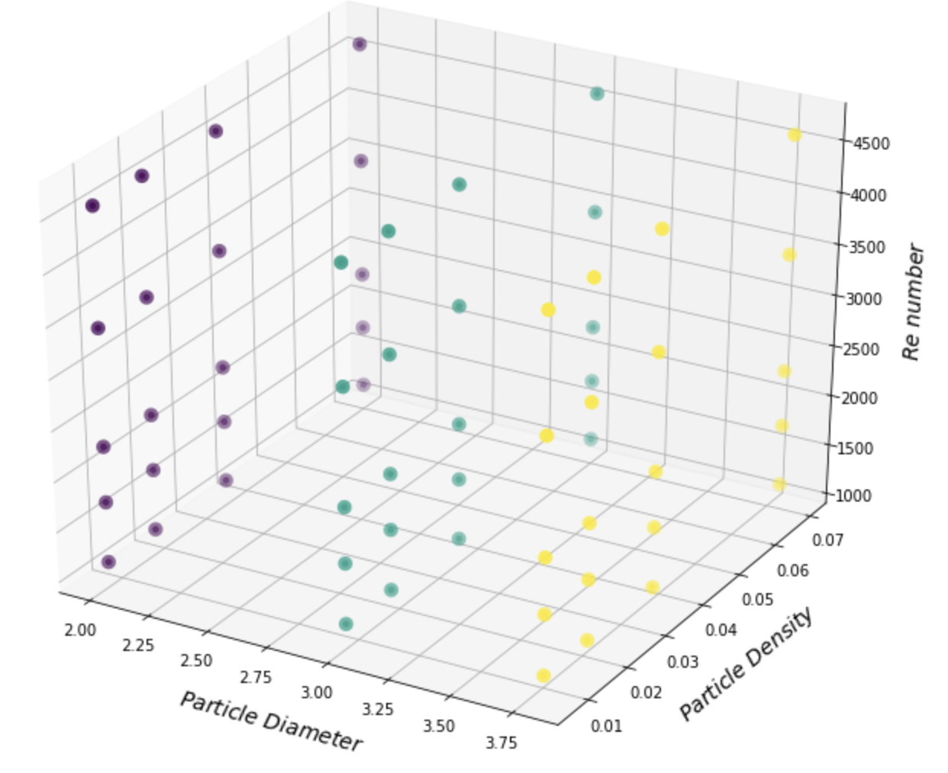
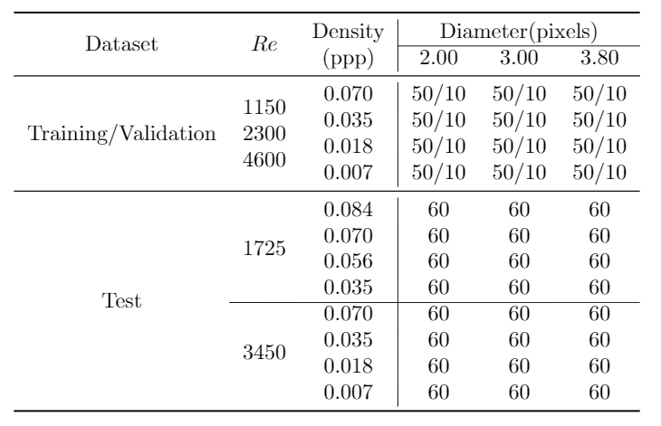
Data Generation
Dataset
Run 66 simulations ( 150 time step each)
1800 samples for training data, 360 for validation
Parameters space
Notes:
To simulate the real particle images well. We choose three key parameters for generating our synthetic dataset. They are particle density, particle diameter and Reynold number. The graph in the left shows the parameter space. Each dot in the space represent a whole simulation with specific parameters. The Reynold number range from 1150 to 4600. And notably, the normal particle density of a particle image for PIV use is 0.07 particle per pixel. In order to simulate the sparse condition, we choose the density range from 0.007 to 0.07. The lowest density is one tenth of the normal condition.

Slide 11
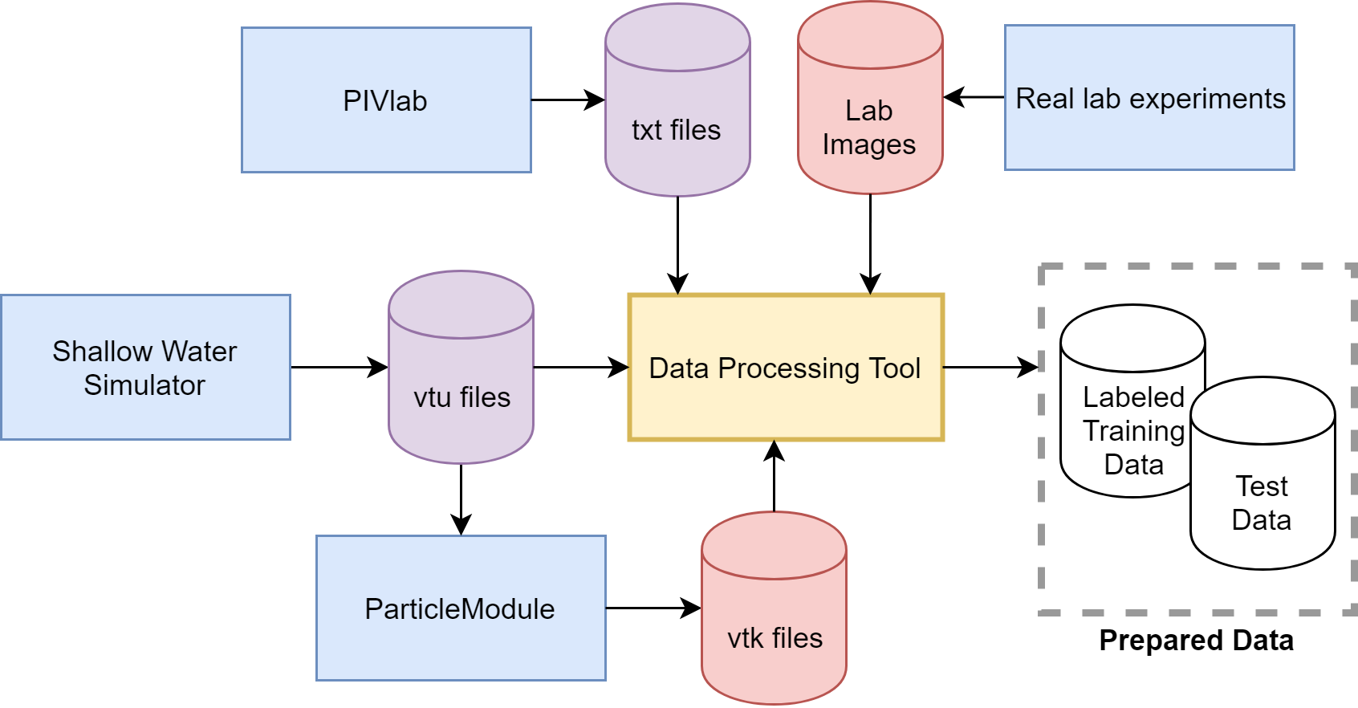
Data Processing
Notes:
Here the graph shows the data processing procedure in this project. There are totally 4 kinds of different data in this project, vtu files of CFD results, vtk files of particle images, txt files of PIVlab results for benchmark and particle images from real lab experiments. All these data will be processed by a data processing tool and finally become labeled training data or test data.

Slide 12
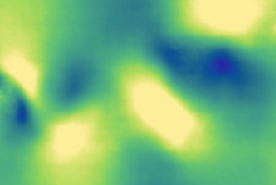
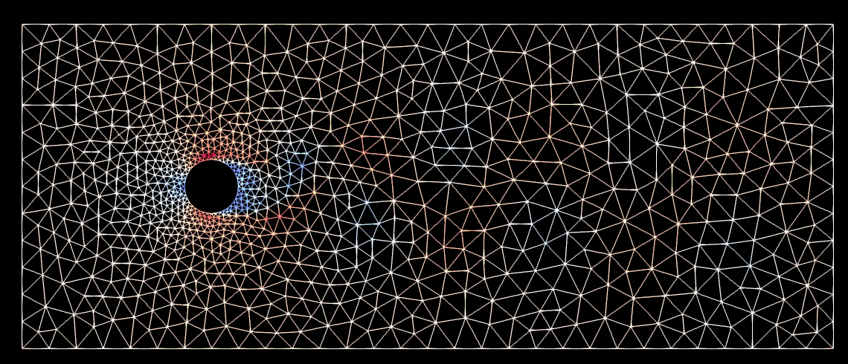
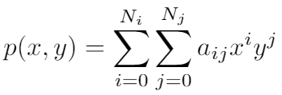
Data Processing
Processing CFD vtu files
The data in the vtu files only contain the velocity values at the grid points
Problems to solve:
Image Construction with right scale
Filling the empty pixels in the image
Solutions:
From physics domain to image domain
Interpolation (bi-linear or bi-cubic)
Interpolation function, N equals to 2 for bi-linear, 3 for bi-cubic
Notes:
This slide shows how to process the CFD vtu files to labels. Because we expect a dense velocity inference, but the vtu files only contain the velocity values at the grid points. So the problem here is how to fill the empty pixels in the image. Here we use the interpolation method, bi-cubic interpolation. By using interpolation, we can get a dense velocity field array.

Slide 13
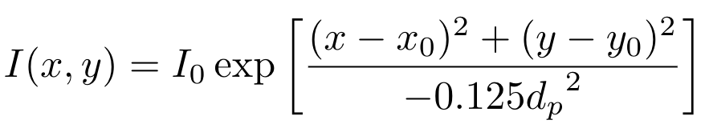
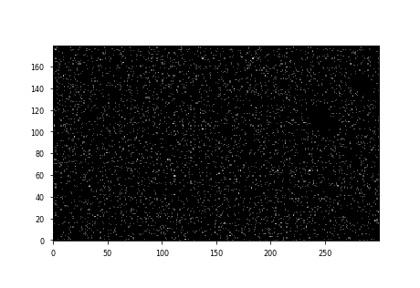
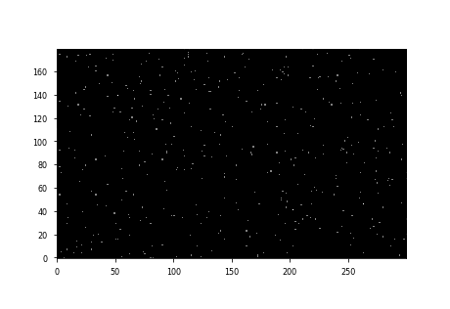
Data Processing
Processing particle vtk files
The data in the vtk files only contain the particle positions of physics domain in different time steps
image domain
Problems to solve:
Image Construction with right scale
Ideal points to real particles
Physics domain
Grey value(illumination) definition
Solutions:
From physics domain to image domain
2D Gaussian distribution
Notes:
In addition to labels, we also need to generate particle images. To model the real particle, we regard the particle as a 2 dimension Gaussian distribution. The definition of the particle gray value is shown here, where the dp represents the diameter of the particle.

Slide 14
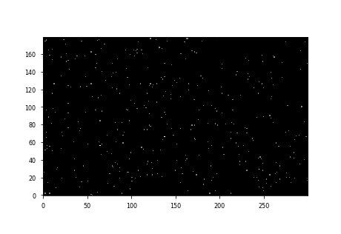
Data Processing
Particle images samples of high and low quality
High quality (density 0.07 ppp)
Low quality (density 0.007 ppp)
Notes:
Here are two example of particle images with high and low quality.

Slide 15
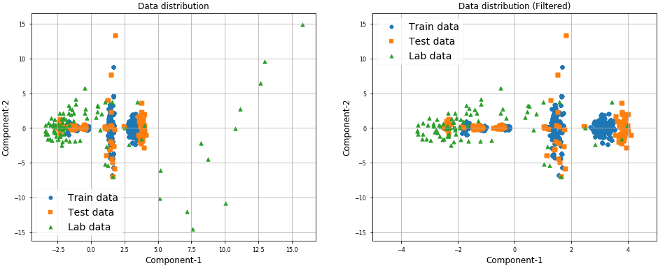
Data Analysis
Reduced-Order using Principle Components Analysis (or called POD)
Notes:
After we got the expected dataset, we did some pre analysis for both training and test data. It is known one pre assumption of deep learning theory is that the training data and test data should comes from similar distribution. It could be observed that the distributions of training data and test data are similar. And they can be regarded as different samples from the same distribution. As for the lab data, although there are some large value noises. After data is filtered by a low pass filter, the remaining distribution is quite similar to the training data.

Slide 16
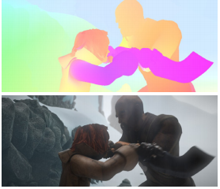
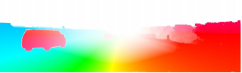
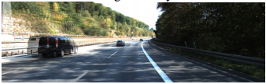
Optical Flow vs Fluid Flow
Optical Flow for rigid body motion detection
Particles in fluid flow “Dense rigid bodies”
Left four pictures comes from:
D. J. Butler, J. Wulff, G. B. Stanley, and M. J. Black, “A naturalistic open source movie for optical flow evaluation,” pp. 611–625, Oct. 2012
E. Ilg, N. Mayer, T. Saikia, M. Keuper, A. Dosovitskiy, and T. Brox, “Flownet2.0: Evolution of optical flow estimation with deep networks,” CVPR, p. 2462–2470, 2017
Notes:
Deep learning and neural network techniques have been widely used in computer vison area. One of the classic problems is optical flow, optical flow could be defined as the velocity of illumination pattern. There are some similiarities between optical flow and fluid flow. They all calculate velocity using image pair. Although the optical flow problems focus on rigid bodies, the particles in fluid flow “Dense rigid bodies”.

Slide 17
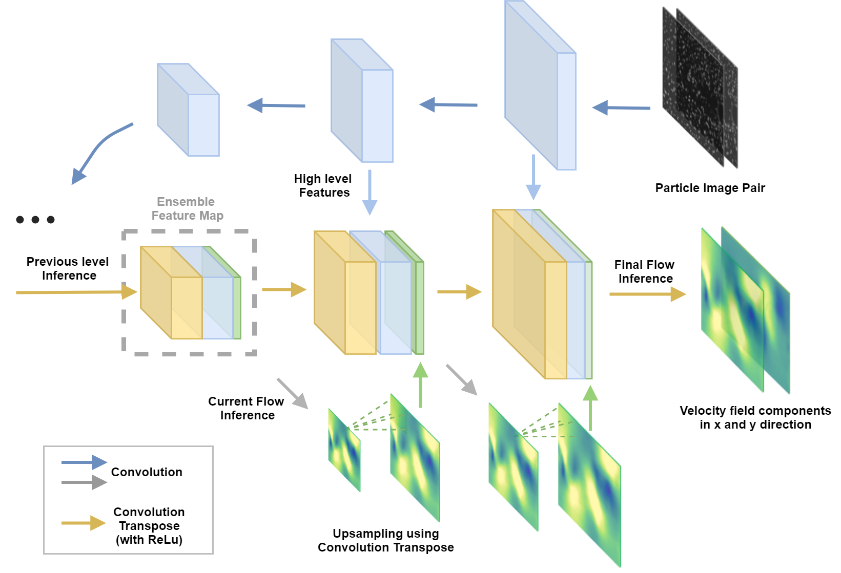
Network Architecture
CONV1(2, 64)
CONV T (68, 2)
Flow Infer1(386, 2)
CONV2(64, 128)
CONV T (68, 2)
Flow Infer2(386, 2)
CONV3(128, 256)
CONV T(194, 2)
Flow Infer3(386, 2)
CONV3-1(256, 256)
CONV T(386, 64)
CONV4(256, 512)
Flow Infer4(770, 2)
CONV4-1(512, 512)
CONV T(770, 128)
CONV5(512, 512)
Flow Infer5(1026, 2)
CONV5-1(512, 512)
CONV T(1026, 256)
CONV6(512, 1024)
Flow Infer6(1024, 2)
CONV6-1(1024, 1024)
CONV T(1024, 512)
Extraction Net
Inference Net
Notes:
Here is the network architecture. The whole network is divided into two part, extraction net and inference net. In the extraction net, the features are extracted by a series convolution layers pramidly. Notably,
In the inference net, a ensamble feature map is utilized as shown in the graph. The yellow part is the inference from previous level, the blue part is the high level features from the extraction net, the green part is the flow field inference in current level. By using the ensamble feature map, the network can do the infer more systematically, and less possible to lose information.

Slide 18
Network Architecture
Reduced-layer Particle-Net
The deep neural network is notorious for being greedy on computation resources. It usually requires hours for training sometimes even for predicting. To speed up the network, a reduced-layer Particle-Net is utilised
CONV T (68, 2)
Bi-linear Interpolation
Flow Infer1(386, 2)
CONV T (68, 2)
Use interpolation methods to substitute inference layers:
Bi-linear interpolation, Bi-cubic interpolation…
Substitute one inference layer : Particle-Net-RL1
Substitute two inference layer : Particle-Net-RL2
Flow Infer2(386, 2)
CONV T(194, 2)
Flow Infer3(386, 2)
Particle-Net-RL1
Particle-Net-RL2
Inference Net
Notes:
To speed up the training process and reduce the memory cost. A reduced-layer Particle-Net is utilised. The strategy is to substitute the two inference layers by bi-linear interpolation.

Slide 19
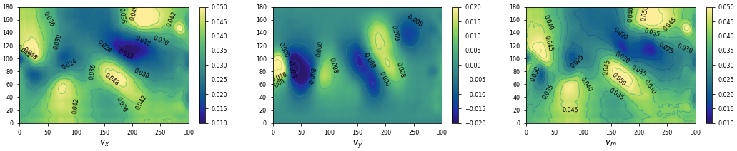
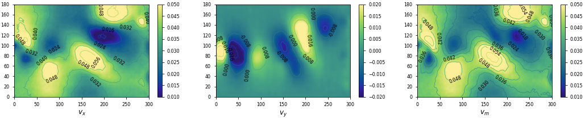
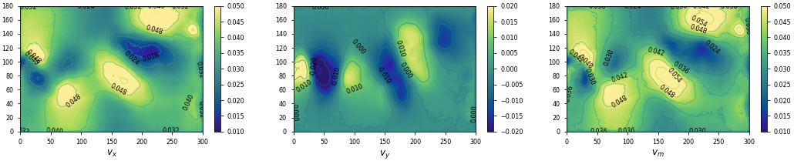
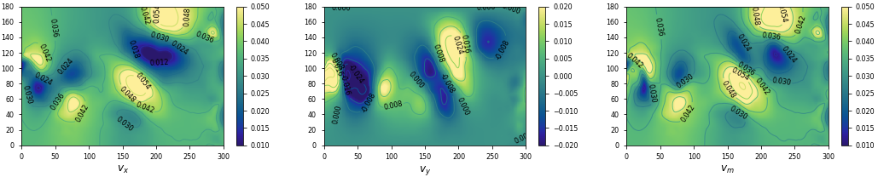
Results
Test on synthetic unseen data
(High quality input particle images)
ParticleNet-RL2
ParticleNet-RL1
ParticleNet
Input particle image pair
(Re3450, Particle density 0.07 ppp)
Ground Truth
Notes:
Here is the comparison of inference results between Particle Net and reduced layers net with high quality particle images. It can be observed that all three inference results are not bad.

Slide 20
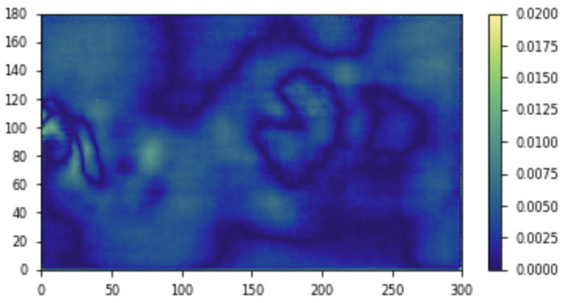
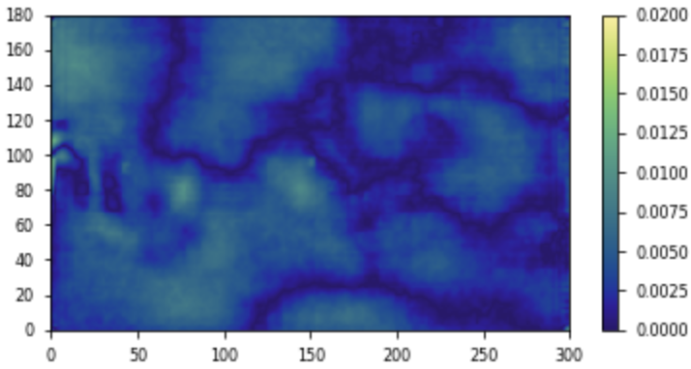
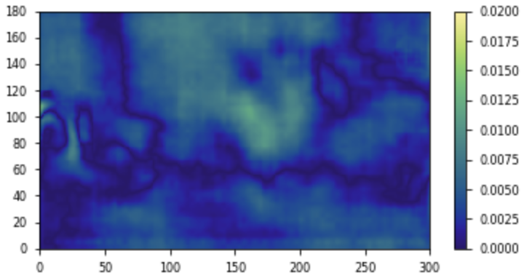
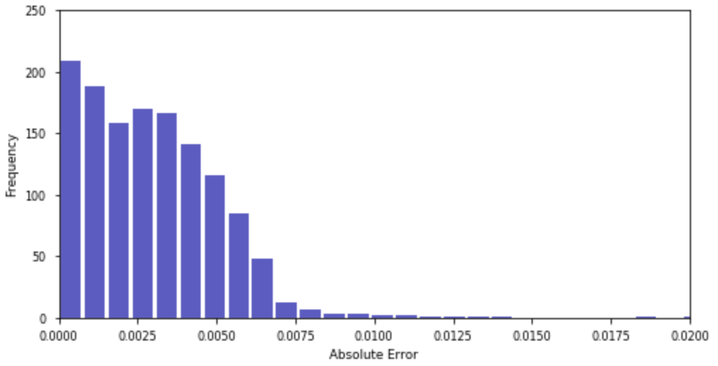
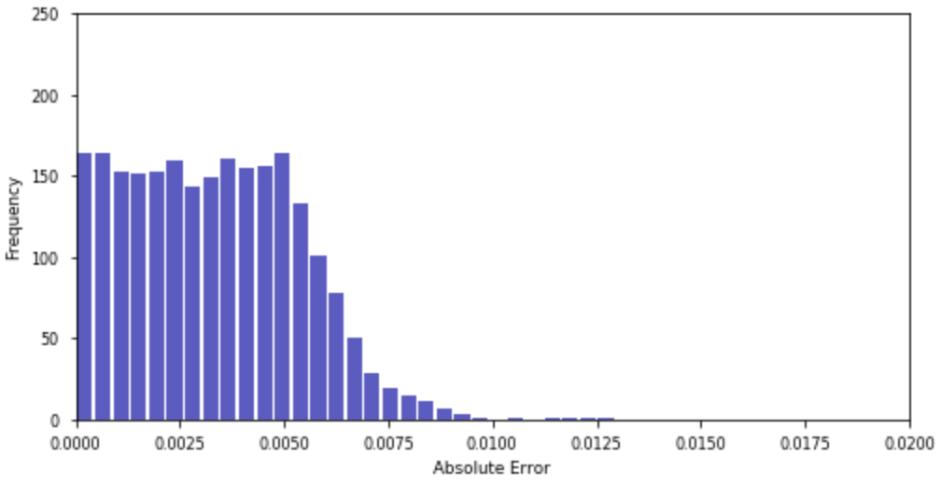
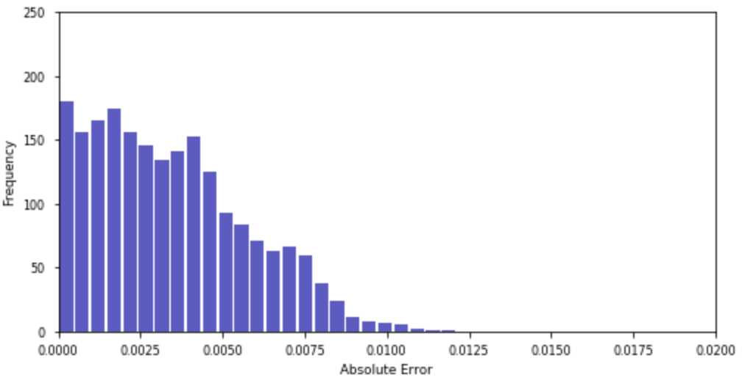
Results
Test on synthetic unseen data - Error map and distribution
(High quality input particle images)
ParticleNet
ParticleNet-RL1
ParticleNet-RL2
Notes:
Here is the comparison of inference results between Particle Net and reduced layers net with high quality particle images. It can be observed that all three inference results are not bad.

Slide 21
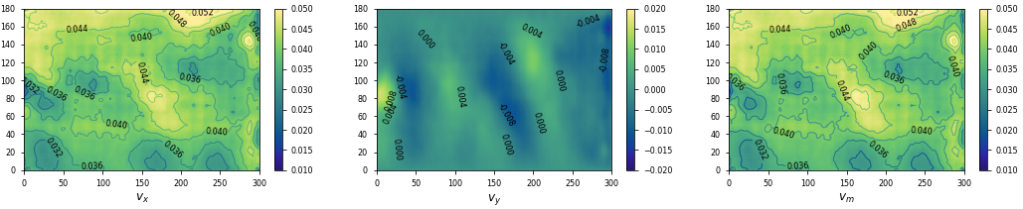
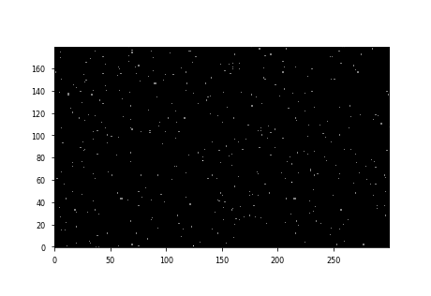
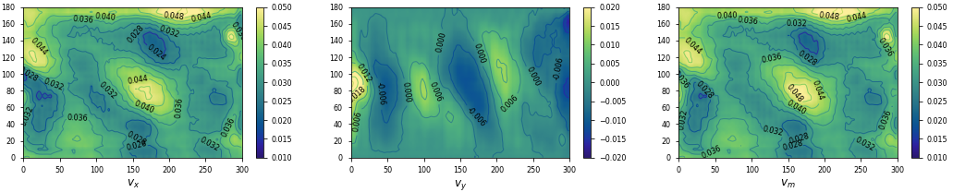
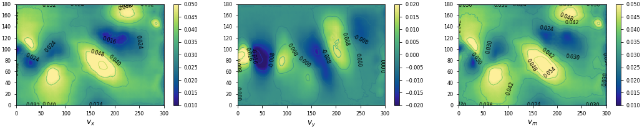
Results
Test on synthetic unseen data
(Low quality input particle images)
ParticleNet-RL2
ParticleNet-RL1
ParticleNet
Input particle image pair
(Re3450, Particle density 0.007 ppp)
Ground Truth
Notes:
And here is the results with low quality input. The reduced layer model shows a much worse inference results obviously. But for the full particle net, the inference is still decent.

Slide 22
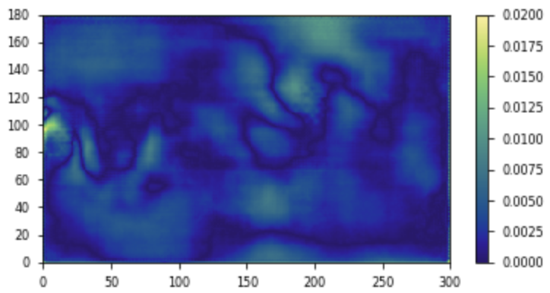
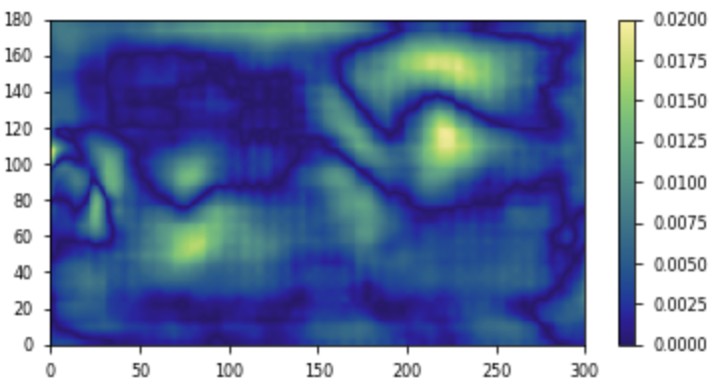
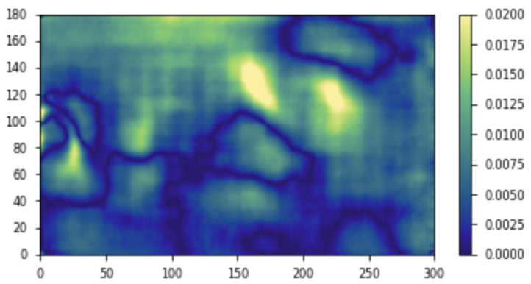
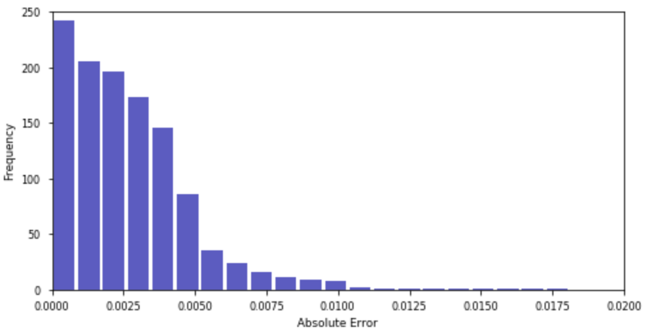
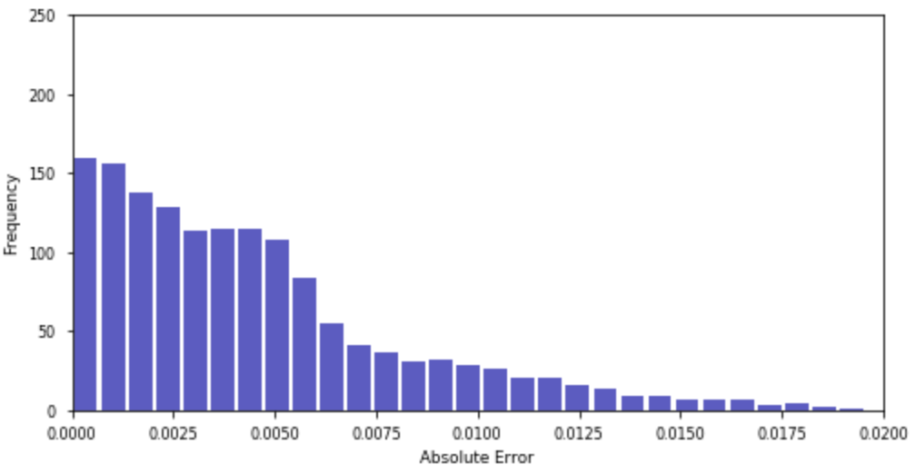
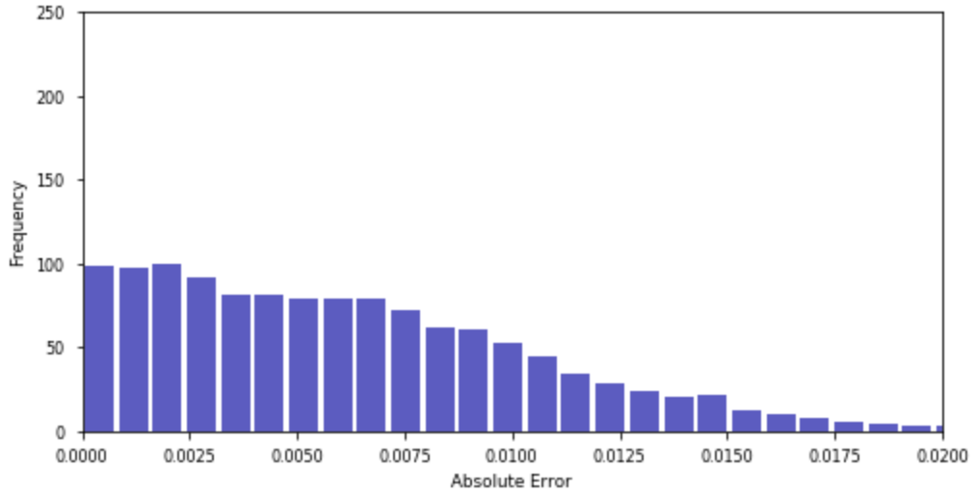
Results
Test on synthetic unseen data - Error map and distribution
(Low quality input particle images)
ParticleNet
ParticleNet-RL1
ParticleNet-RL2
Notes:
Here is the comparison of inference results between Particle Net and reduced layers net with high quality particle images. It can be observed that all three inference results are not bad.

Slide 23
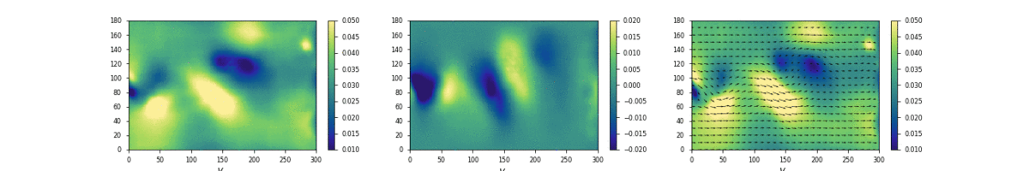



Results
Test on synthetic unseen data
(Low quality input particle images)
Inference
(ParticleNet)
Ground Truth
$$V_{x}$$
$$V_{y}$$
$$V_{m}$$
Notes:
Here is the comparison between the inference result and the ground truth. The input is the low quality images. It can be observed that the neural network did a quite good job.

Slide 24
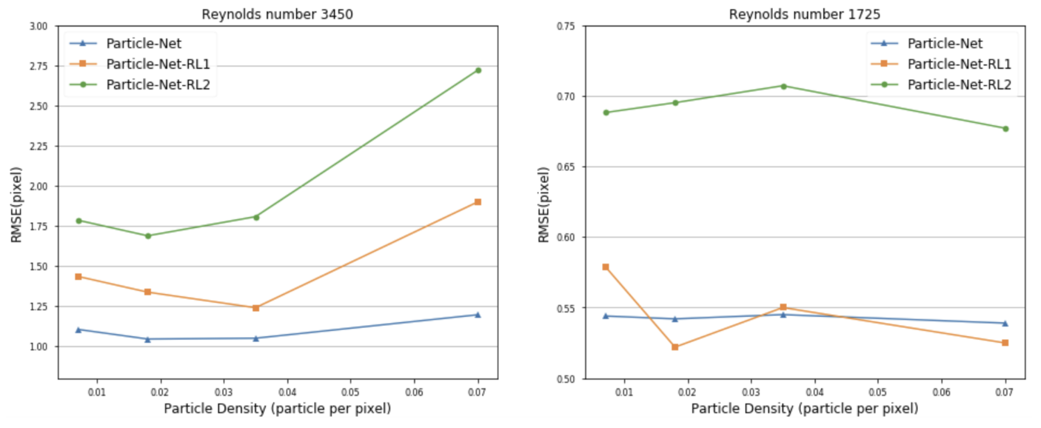
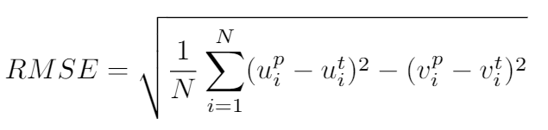


Results
Error definition
Notes:
Here are the all experiment results. There two error definition, root mean square error and relative error. And it seems as there are more layers, the root mean square error is smaller.

Slide 25

Results
Comparison with PIVlab
PIVlab is a time-resolved particle image velocimetry (PIV) software that is updated regularly with software fixes and new features.
- multi-pass, multi grid window deformation technique
- The built-in window deformation iterative multi-grid method (WIDIM) in PIVlab is applied in the comparison experiments with four-pass configurations. The four interrogation areas are 32, 24, 12, 6 respectively, half the default value.
William Thielicke (2019). PIVlab - particle image velocimetry (PIV) tool (https://www.mathworks.com/matlabcentral/fileexchange/27659-pivlab-particle-image-velocimetry-piv-tool), MATLAB Central File Exchange. Retrieved September 5, 2019.
Notes:
PIVlab is a state of the art PIV software which is installed in MATLAB. Here we use it to do the traditional PIV techniques.

Slide 26

Results
Comparison with PIVlab
(High quality input particle images)
PIVlab Result
ParticleNet
Input particle image pair
(Particle density 0.07 ppp)
Ground Truth
Notes:
Here is the comparison on high quality images. It can be observed that the PIV does a fair job but with lots of noises. On the other hand, the neural network performs a better job.

Slide 27



Results
Comparison with PIVlab - Error map and distribution
(High quality input particle images)
ParticleNet
PIVlab Result
Notes:
Here is the comparison of inference results between Particle Net and reduced layers net with high quality particle images. It can be observed that all three inference results are not bad.

Slide 28

Results
Comparison with PIVlab
(Low quality input particle images)
PIVlab Result
ParticleNet
Input particle image pair
(Particle density 0.007 ppp)
Ground Truth
Notes:
As for the low quality images, the difference is much more obvious. The PIV technique can not even capture the flow structure, while neural network still gives decent inference.

Slide 29



Results
Test on synthetic unseen data - Error map and distribution
(Low quality input particle images)
ParticleNet
PIVlab Result
Notes:
Here is the comparison of inference results between Particle Net and reduced layers net with high quality particle images. It can be observed that all three inference results are not bad.

Slide 30



Results
Test on lab data
Sample of lab data
Lab setting (image credit: Mr Lucas Mackie and Mr Raul Adriaensen)
Notes:
Finally, the network also tested on lab data. The lab setting simulates the computational setting in a water tank.

Slide 31




Results
Test on lab data
Network inference (different time steps)
PIV result (different time steps)
Notes:
Show the results in different time step. It can be observed that the inference is quite similar. Although there some difference, but we don’t know which one is the exact correct. We need further steps to do the benchmarks.

Slide 32

Results
Test on lab data
Mean velocity and its standard deviation (from cylinder centre to end of the downstream)
Notes:
Here is the mean velocity and its standard deviation from the cylinder centre to end of the downstream. It can be observed that the tendancy and profile are quite match.

Slide 33

Results
Efficiency
Notes:
Also, the efficiency is also compared. The neural network shows a great advantage on efficiency. There are 120 images to process in the test experiment. The PIVlab requires about 100 seconds to finish the task. While neural network only requires about 4 second including loading the model. Because the model is only needed to load for once, so the true prediction time is only about 1.6 second for one image and the frame processed per second can reach nearly 72. Generally, it only requires 25 frames per second for animation. So it is very promising for the neural network can perform real-time processing.

Slide 34
Discussion
Project highlights
Developed and implemented the new Particle-Net
Demonstrated that it outperforms state-of-the-art PIV software PIVlab (WIDIM method) for synthetically generated data, both in terms of accuracy and efficiency, especially when considering extremely low-quality particle images
Software written for flow field particle data generation, including use of Thetis CFD software
Developed synthetic and lab based data processing/analysis tool

Slide 35
Discussion
Future work
Train on a larger dataset – different kinds of flows
Combine with traditional robust approaches for feature extraction, such as the variational method to enhance the extracted features
Reduce layers while maintaining accuracy
Separate extraction net for each image per pair
Possible Applications
Faster, better lab diagnostic tool
Coastal flow inference from unmanned aerial vehicle photos and high-resolution satellites
Real-time coastal hazard monitoring
…

Slide 36
Q & A

Slide 37
Thank you

